Slide 1



Slide 2
Mapping of the events and creation of the plan of action ( by end 2014)
Name of coordinator for yatra
Yatrsa with coordinators:
Germany – Dina-Sharana dd , UK& Ireland - Devaki Dasi , Belgium -Mahaprabu das , Hungary -Gandharvika Prema dd, Italy- Dayanidhi das, Croatia -Isvara puri das, Macedonia -Vraja Kisor das, Norway -Yudhistira das, Denmark -Janeshvara prabhu
Plan of action for yatras
1. Events specially created for this occasion ( according to the target population – devotees, general public, media, politicians, youth...)
(examples: interreligious meetings, conferences, VIP events, concerts , expeditions, drama, ratha-ytras...)
2. Events that will be dedicated for 50th anniversary celebrations ( festivals, ratha-ytras, kirtans...)

Slide 3
One big event for the Europe
London?
Suggestions

Slide 4
Conclusion after the meeting:
To appoint coordinators
To send the Plan of action
( to fill the form)

Slide 5
THANK YOU
Contact:
madayanti.sns @gmail.com

Slide 6
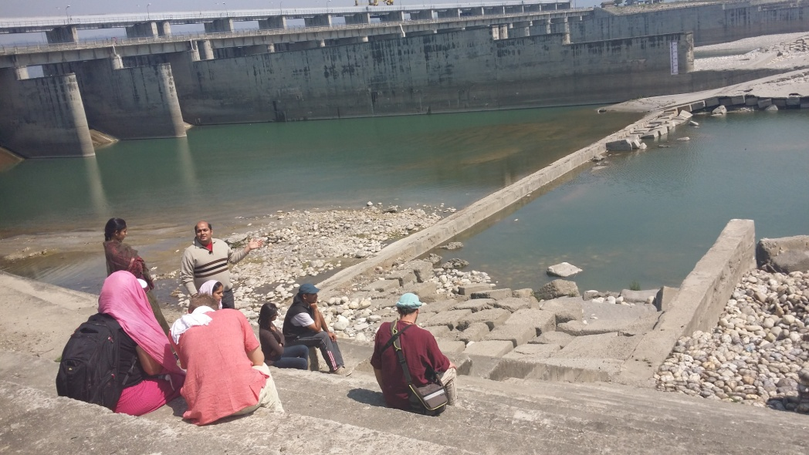
Save Yamuna Campaign www.saveyamuna.org

Slide 7
Action by Mann Mandir from Varsana
Maan Mandir has actually picked up speed and volume since it has parted ways with Yamuna Rakshak Dal. True brajwasis have expressed relief and strengthen the campaign. Many more brajwasi leaders have now joined in.
the best that has happened is the formation of the new Central government with Narendra Modi as the new Prime Minister. He has publicly assured of cleansing Ganga & Yamuna and has actually formed a special new ministry for this purpose. Miss Uma Bharti ji is the minister.
Maan Mandir representatives have met her and the concerned officials. However, the new ministry is evaluating several option before it sets into action and this is taking time.
Meanwhile, the Supreme court has gone slow and their is hardly any movement.
The National Green Tribunal is moving at good speed and involved two IIT's, India's premier Engineering Institutes to formulate a practical solution to clean River YamunaThe need for Minimum Eco Flow has been suggested in the new committee.
The local populations of Mathura, Vrindavan are whole heartedly joining in the various big demonstrations being held there. The Local Member of Parliament is also sensitized.
People are looking up to the March 1st 2015 deadline that has been given to the new Government to act.

Slide 8
Iskcon
What we can do?
To remind authorities on their obligation ( to send the letters or to meet Indian authorities)
To involve media
To make awareness among devotees and general public

Slide 9
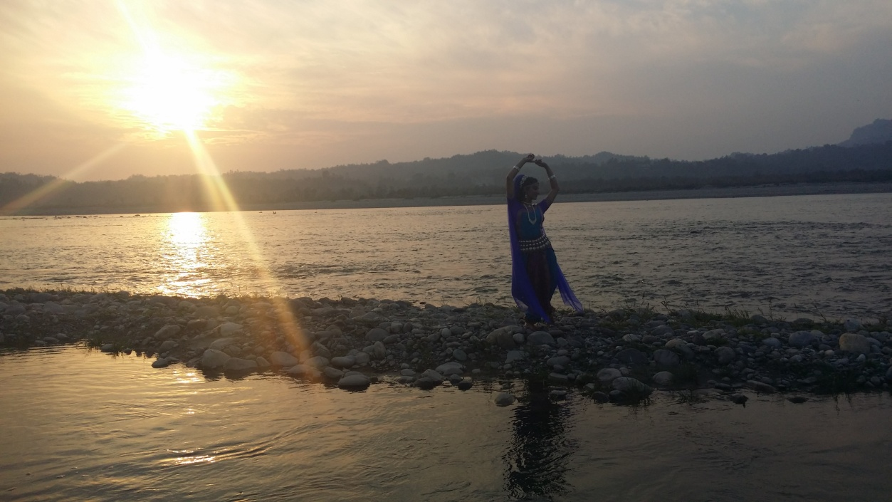
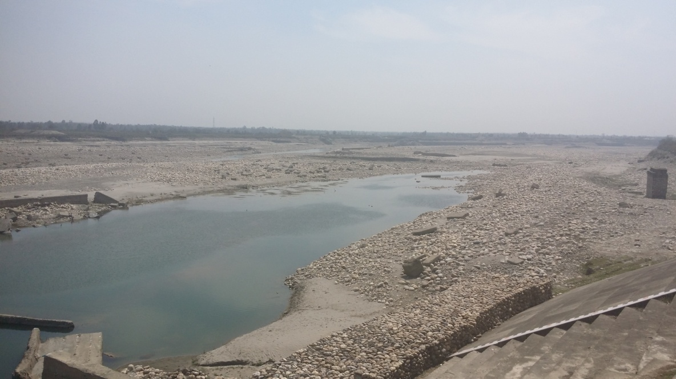
Adequate flow of Natural Fresh Waters of Yamnotri to flow on the Entire stretch of Yamuna River Bed.
Yamuna before
Hatni kund
barrage
Yamuna after Hatni kud barrage

Slide 10
THANK YOU
Contact:
madayanti.sns @gmail.com

